Slide 1
Lecture 12 – Depth-First Search
CST370 – Design & Analysis of Algorithms
Dr. Byun
Computer Science

Slide 2
Lecture Objectives
After completion of this lecture, you will be able to
  perform the depth-first search (DFS) to visit all vertices of a graph.

Slide 3
Chapter 3: Brute Force and Exhaustive Search
3.1 Selection Sort and Bubble Sort
3.2 Sequential Search and Brute-Force String Matching
3.3 Closest-Pair and Convex-Hull Problems by Brute Force
3.4 Exhaustive Search
3.5 Depth-First Search and Breadth-First Search

Slide 4
Graph Traversal
Many graph problems require processing all vertices (and edges) of a graph in a systematic way.
There are two popular graph search algorithms.
  Depth-First Search (DFS)
  Breadth-First Search (BFS)

Slide 5
Depth-First Search (DFS) Algorithm
To get the basic idea of DFS, watch this video.
  http://y2u.be/iaBEKo5sM7w
  Remember that DFS uses a stack for its operation.

Slide 6
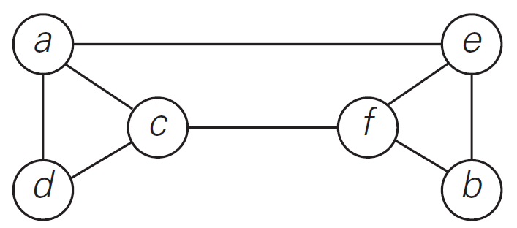
DFS Example (1 of 3)
Watch this video to understand the detailed operation of DFS for the graph below.
  http://y2u.be/Hv8Gjp2zpCY
  Note that we use a “mark” array to indicate whether a vertex has already visited or not.
  The video also presents a DFS tree with edges called “tree edges”.

Slide 7
DFS – Example (2 of 3)
a
b
c
d
e
f
Stack
Mark Array

Slide 8
DFS Example (3 of 3)
DFS tree with “(tree) edges”.
  The order of children in the DFS tree is not important. So, either the left tree or right tree is fine.
a
a
c
c
d
f
f
d
b
b
e
e

Slide 9
DFS Algorithm
A vertex is pushed onto the stack when it’s reached for the first time.
A vertex is popped off the stack when it becomes a dead end (= there is no more adjacent unvisited vertex).

Slide 10
Exercise
Starting at the vertex a, conducting the DFS algorithm for the graph below.
  Then, present the result of mark array and draw a DFS tree.
a
b
c
d
e
f
g
h

Slide 11
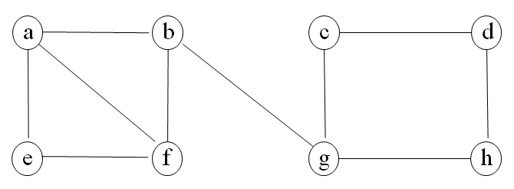
Solution
a
b
c
d
e
f
g
h
Stack
Mark Array

Slide 12
Exercise – Disconnected Graph

Slide 13
DFS – Time Efficiency (1 of 2)
Watch the video to get the basic idea of time efficiency.
  http://y2u.be/T6pAtlEpm_o
  Note that the time efficiency of the DFS algorithm depends on the data structure used to represent the graph.

Slide 14
DFS – Time Efficiency (2 of 2)
For the adjacency matrix representation, the traversal time is in Θ(|V|²).
For the adjacency list representation, it is in Θ(|V| + |E|) where |V| and |E| are the number of the graph’s vertices and edges, respectively.

Slide 15
Applications of DFS
Checking connectivity
Checking acyclicity of a graph
Finding connectivity components
etc.

